Slide 1
Lecture 5
Data Stream Mining

Slide 2
Outline
What is data stream?
What is Concept Drift?
Concept drift detection
Data stream classification
Data stream clustering

Slide 3

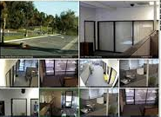


Internet
Surveillance
Spam Filtering
DATA STREAM
Network Intrusion
Industry
Mobile
Smart Phone
Sensor
*Note: some pictures derived from internet

Slide 4
Potential Applications
Telecommunication calling records
Business: credit card transaction flows
Network monitoring and traffic engineering
Financial market: stock exchange
Engineering & industrial processes: power supply & manufacturing
Sensor, monitoring & surveillance: video streams, RFIDs
Security monitoring
Web logs and Web page click streams

Slide 5
What is data stream?
A data stream is a massive sequence of data objects which have some unique features:
One by One
Potentially Unbounded
Concept Drift
data4
data3
data2
data1
Data mining system
Data stream

Slide 6
Challenges
Data Stream: (a) Infinite Length (b) Evolving Nature
Single Pass Handling
Memory Limitation
Low Time Complexity
Concept Drift

Slide 7
What is concept drift？
In predictive analytics and machine learning, the concept drift means that the statistical properties of the target variable, which the model is trying to predict, change over time in unforeseen ways.
In a word, the probability distribution changes.
Change in P(C)
Change in P(X)
Change in P(C|X)

Slide 8
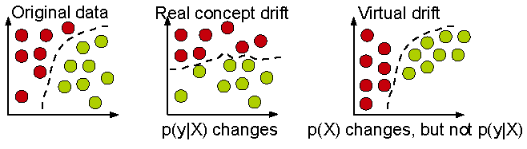
Real concept drift vs. Virtual concept drift

Slide 9
Example: Concept-Drift
Current hyperplane
Previous hyperplane
A data chunk
Negative instance
Instances victim of concept-drift
Positive instance
Notes:
Suppose we divide the data stream into equal sized chunks
This is a data chunk, where each data point is two dimensional
A hyperplane separates the data points into two classes: positive and negative
Suppose this is the next data chunk
We see that the hyperplane has shifted
As a result, some data points that were negative according to the previous hyperplane, are now positive -> this indicates concept-drift
In the next data chunk, we see again the hyperplane has shifted, and some data points changed their label
9

Slide 10
1、 Concept Drift Detection

Slide 11
1. Distribution-based detector
Monitoring the change of data distributions between two fixed or adaptive windows of data. (e.g. ADWIN)
w₁
w₂
Hard to determine window size
Learn concept drift slower
Virtual concept drift

Slide 12
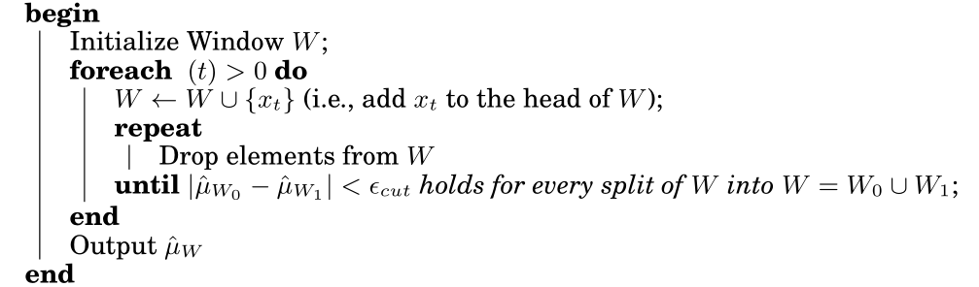
Adaptive Windowing（ADWIN）
The idea is simple: whenever two “large enough” subwindows of W exhibit “distinct enough” averages, one can conclude that the corresponding expected values are different,and the older portion of the window is dropped.
Bifet et al., Learning from Time-Changing Data with Adaptive Windowing

Slide 13
2. Error-rate based detector
Capture concept drift based on the change of the classification performance. (i.e. comparing the current classification performance to the average historical error rate with statistical analysis.) (e.g. PHT)
Infer time-changing concept relying on performance degradation
Indirectly
Sensitive to noise
Hard to deal with gradual concept drift
Depend on learning model itself heavily

Slide 14
Drift detection method: DDM
A significant increase in the error of the algorithm, suggest a change in the class distribution, and whether is a significant increase is based on following formula.
the error-rate is the probability of observed False,
, with standard deviation given by

Slide 15
2、Data Stream Classification

Slide 16
Data stream classification
Classification: Model construction based on training sets
Typical classification methods
K-Nearest neighbor approach
Decision tree
Bayesian classification
Neural network approach
Support Vector Machines
Other methods
Are these approaches ok for data stream classification?

Slide 17
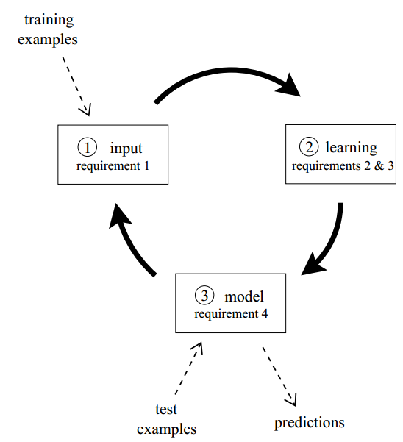
Data stream classification Circle
Process an example at a time, and inspect it only once
Be ready to predict at any point
Use a limited amount of memory
Work in a limited amount of time

Slide 18
Procedure
The algorithm is passed the next available example from the stream (requirement 1)
The algorithm processes the example, updating its data structures. It does so without exceeding the memory bounds set on it (requirement 2), and as quickly as possible (requirement 3).
The algorithm is ready to accept the next example. (requirement 4)

Slide 19
Typical algorithms
VFDT (Very Fast Decision Tree, KDD’00)
CVFDT (KDD’01)
SyncStream (Shao et al., KDD’14)

Slide 20
Decision Tree Learning
One of the most effective and widely-used classification methods
Induce models in the form of decision trees
Each node contains a test on the attribute
Each branch from a node corresponds to a possible outcome of the test
Each leaf contains a class prediction
Age<30?
Yes
No
Car Type=
Sports Car?
Yes
Yes
No
No

Slide 21
Challenges
Classic decision tree learners assume all training data can be simultaneously stored in main memory
Disk-based decision tree learners repeatedly read training data from disk sequentially
Prohibitively expensive when learning complex trees
Goal: design decision tree learners that read each example at most once, and use a small constant time to process it

Slide 22
VFDT (Very Fast Decision Tree)
A decision-tree learning system based on the Hoeffding tree algorithm
In order to find the best attribute at a node, it may be sufficient to consider only a small subset of the training examples that pass through that node.
Given a stream of examples, use the first ones to choose the root attribute.
Once the root attribute is chosen, the successive examples are passed down to the corresponding leaves, and used to choose the attribute there, and so on recursively.
Use Hoeffding bound to decide how many examples are enough at each node

Slide 23
How many examples are enough?
Let G(X_{i}) be the heuristic measure used to choose test attributes (e.g. Information Gain, Gini Index)
X_{a} : the attribute with the highest attribute evaluation value after seeing n examples.
X_{b} : the attribute with the second highest split evaluation function value after seeing n examples.
Given a desired , if after seeing n examples at a node,
Hoeffding bound guarantees the true , with probability 1-.
This node can be split using X_{a}, the succeeding examples will be passed to the new leaves.

Slide 24
Hoeffding Bound
Hoeffding's inequality: A result in probability theory that gives an upper bound on the probability for the sum of random variables to deviate from its expected value
Based on Hoeffding Bound principle, classifying different samples leads to the same model with high probability —can use a small set of samples
Hoeffding Bound (Additive Chernoff Bound)
Given: r: random variable, R: range of r, N: # independent observations
True mean of r is at least r_{avg} – ε, with probability 1 – δ (where δ is user-specified)

Slide 25
Algorithm
Calculate the information gain for the attributes and determines the best two attributes
At each node, check for the condition
If condition satisfied, create child nodes based on the test at the node
If not, stream in more examples and perform calculations till condition satisfied

Slide 26
Age<30?
Data Stream
Yes
No
Yes
Age<30?
Data Stream
Yes
No
Car Type=
Sports Car?
Yes
Yes
No
No

Slide 27
VFDT: Strengths and Weaknesses
Strengths
Scales better than traditional methods
Sublinear with sampling
Very small memory utilization
Incremental
Make class predictions in parallel
New examples are added as they come
Weakness
Could spend a lot of time with ties
Memory used with tree expansion
Number of candidate attributes

Slide 28
CVFDT
CVFDT (Concept-adapting Very Fast Decision Tree learner)
Extend VFDT
Maintain VFDT’s speed and accuracy
Detect and respond to changes in the example-generating process

Slide 29
Observations
With a time-changing concept, the current splitting attribute of some nodes may not be the best any more.
An outdated subtree may still be better than the best single leaf, particularly if it is near the root.
Grow an alternative subtree with the new best attribute at its root, when the old attribute seems out-of-date.
Periodically use a bunch of samples to evaluate qualities of trees.
Replace the old subtree when the alternate one becomes more accurate.
Notes:
Source producing examples may significantly change behavior
Some splits that previously passed the Hoeffding test will no longer do so, because an alternative attribute now has higher gain.
Stay current wile make the most of the old data.
to enable smooth, fine-grained adjustments when concept drift occurs

Slide 30
CVFDT algorithm
Alternate trees for each node in HT start as empty.
Process examples from the stream indefinitely. For each example (x, y),
Pass (x, y) down to a set of leaves using HT and all alternate trees of the nodes (x, y) passes through.
Add (x, y) to the sliding window of examples.
Remove and forget the effect of the oldest examples, if the sliding window overflows.
CVFDTGrow
CheckSplitValidity if f examples seen since last checking of alternate trees.
Return HT.

Slide 31
CVFDT: process each example
Pass example down to leaves
add example to sliding window
Yes
Window overflow?
Forget oldest example
Read new example
No
CVFDTGrow
f examples since last checking?
Yes
No
CheckSplitValidty

Slide 32
CVFDT algorithm: process each example
Pass example down to leaves
add example to sliding window
Yes
Window overflow?
Forget oldest example
Read new example
No
CVFDTGrow
f examples since last checking?
Yes
No
CheckSplitValidty

Slide 33
CVFDTGrow
For each node reached by the example in HT,
Increment the corresponding statistics at the node.
For each alternate tree T_{alt} of the node, CVFDTGrow
If enough examples seen at the leaf in HT which the example reaches,
Choose the attribute that has the highest average value of the attribute evaluation measure (information gain or gini index).
If the best attribute is not the “null” attribute, create a node for each possible value of this attribute

Slide 34
CVFDT algorithm: process each example
Pass example down to leaves
add example to sliding window
Yes
Window overflow?
Forget oldest example
Read new example
No
CVFDTGrow
f examples since last checking?
Yes
No
CheckSplitValidty

Slide 35
Forget old example
Maintain the sufficient statistics at every node in HT to monitor the validity of its previous decisions.
VFDT only maintain such statistics at leaves.
HT might have grown or changed since the example was initially incorporated.
Assigned each node a unique, monotonically increasing ID as they are created.

Slide 36
CVFDT algorithm: process each example
Pass example down to leaves
add example to sliding window
Yes
Window overflow?
Forget oldest example
Read new example
No
CVFDTGrow
f examples since last checking?
Yes
No
CheckSplitValidty

Slide 37
CheckSplitValidtiy
Periodically scans the internal nodes of HT.
Start a new alternate tree when a new winning attribute is found.
Tighter criteria to avoid excessive alternate tree creation.
Limit the total number of alternate trees.

Slide 38
Smoothly adjust to concept drift
Age<30?
Alternate trees are grown the same way HT is.
Periodically each node with non-empty alternate trees enter a testing mode.
M training examples to compare accuracy.
Prune alternate trees with non-increasing accuracy over time.
Replace if an alternate tree is more accurate.
Yes
No
Married?
Car Type=
Sports Car?
Yes
Yes
No
Yes
No
Yes
No
No
Experience
<1 year?
Yes
No
No
Yes

Slide 39
Adjust to concept drift
Dynamically change the window size
Shrink the window when many nodes gets questionable or data rate changes rapidly.
Increase the window size when few nodes are questionable.

Slide 40
Prototype-based Data Stream Classification

Slide 41
41
Motivation
Motivation
Single model learning: Learn and update a classification model by training on a fixed or adaptive window of recent incoming examples, suffers in the presence of concept drift.
Ensemble learning: Train a number of base classifiers to capture evolving concepts.
P₁
P₂
Black-box Fashion
Data Selection for Training
t0
t1
t2

Slide 42
42
Basic Idea
Prototype-based Learning: An intuitive way is to dynamically select the short-term and/or long-term representative examples to capture the trend of time-changing concepts.
P₁
P₂
t0
t1
t2
Online Data Maintenance: P-Tree
Prototypes Selection: Error-driven representativeness learning and synchronization-inspired constrained clustering
Sudden Concept Drift: PCA and Statistics
Lazy Learning: KNN

Slide 43
43
Online Data Maintenance: P-TREE
Concept Level
…
Time-changing Concepts
1
2
maxC-1
maxC
Prototype Level
Incoming examples
1
2
3
4
…
maxP
A small set of prototypes (e.g. maxP =1000)
P-Tree is additionally updated:
Maximum boundary (Synchronization-based data representation)
Sudden concept drift (Rebuild the Prototype Level)

Slide 44
44
Error-driven Representativeness Learning
How to dynamically select the short-term and/or long-term representative examples?
Basic idea: Leverage the prediction performance of test examples to infer the representativeness of examples by lazy learning: nearest neighbor classifier.
Rep(y) = Rep(y) + Sign(x_{pl} , x_{l})
where Sign(x, y) is the sign function, and 1 if x equals y, -1 otherwise.
High representativeness —— Keep
Low representativeness —— Delete
Unchanged representativeness? —— Summarization

Slide 45
45
Data Summarization by synchronization
Summarization: Constrained Clustering by Synchronization
Cannot Link
P1
(a) Constrained clustering by synchronization
(b) Prototype-based data representation

Slide 46
46
Abrupt Concept Drift Detection
Principle Component Analysis (PCA): Analyze the change of each class data distribution by principle component of two sets of examples.
V_{Dt}¹(1)
V_{Dt+1}¹(2)
V_{Dt}¹(1)
V_{Dt}¹(2)
θ₁
D_{t+1}¹
V_{Dt+1}¹(1)
D_{t}¹
V_{Dt}²(1)
max(θ₁,θ₂)
V_{Dt+1}¹(1)
V_{Dt}²(1)
θ₂
V_{Dt+1}²(1)
V_{Dt+1}²(1)
Data Chunk D_{t}
Data Chunk D_{t+1}
PCA-based concept drift analysis

Slide 47
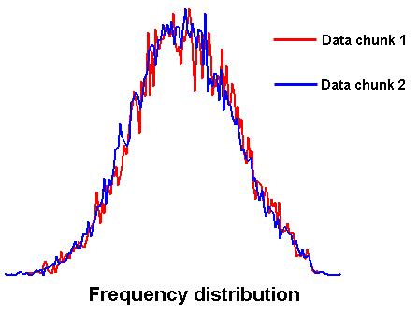
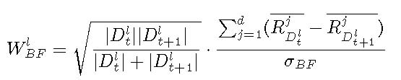
47
Abrupt Concept Drift Detection
Statistical Analysis: Compute a suitable statistic, which is sensitive to data class distribution changes between the two sets of examples.

Slide 48
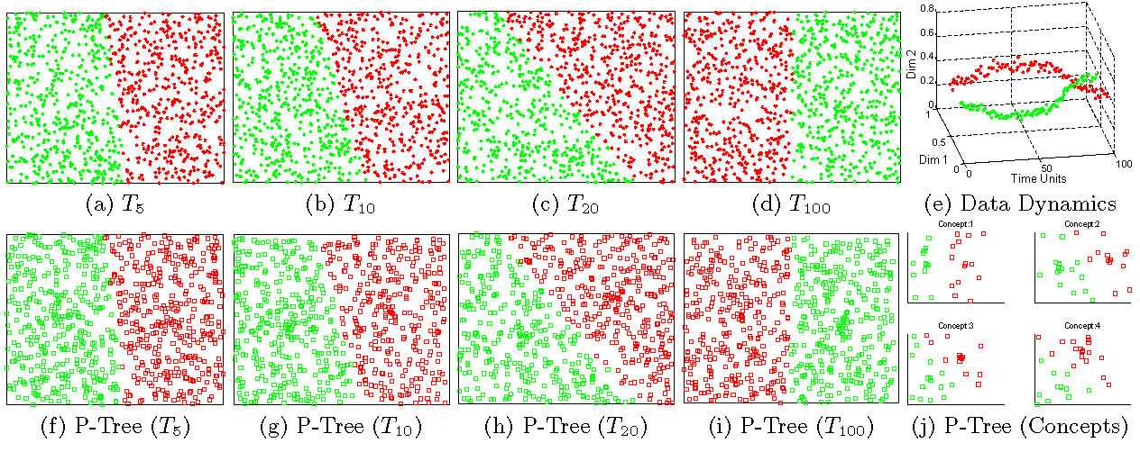
48
Proof of Concept
Concept Modeling
(1) Synthetic data stream with gradual concept drift

Slide 49
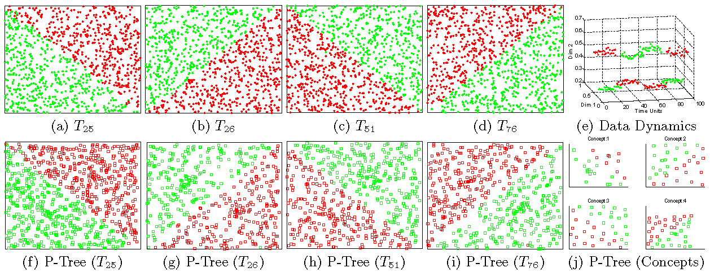
49
Proof of Concept
(2) Synthetic data stream with sudden concept drift

Slide 50
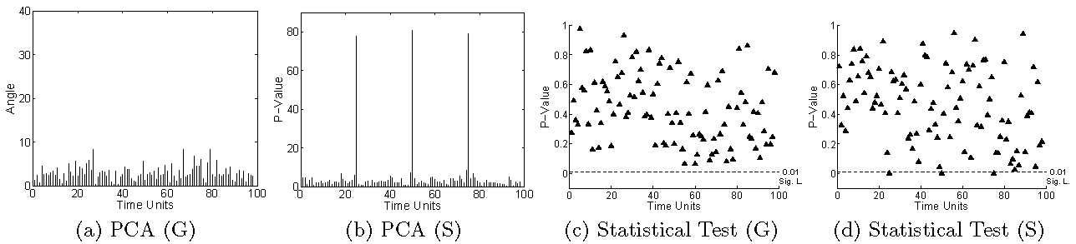
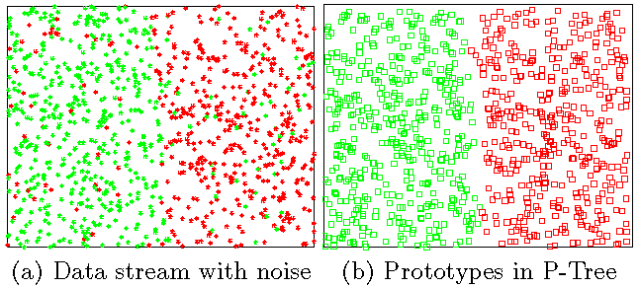
50
1. Proof of Concept
Sudden concept drift detection
Prototype-based Data Representation

Slide 51
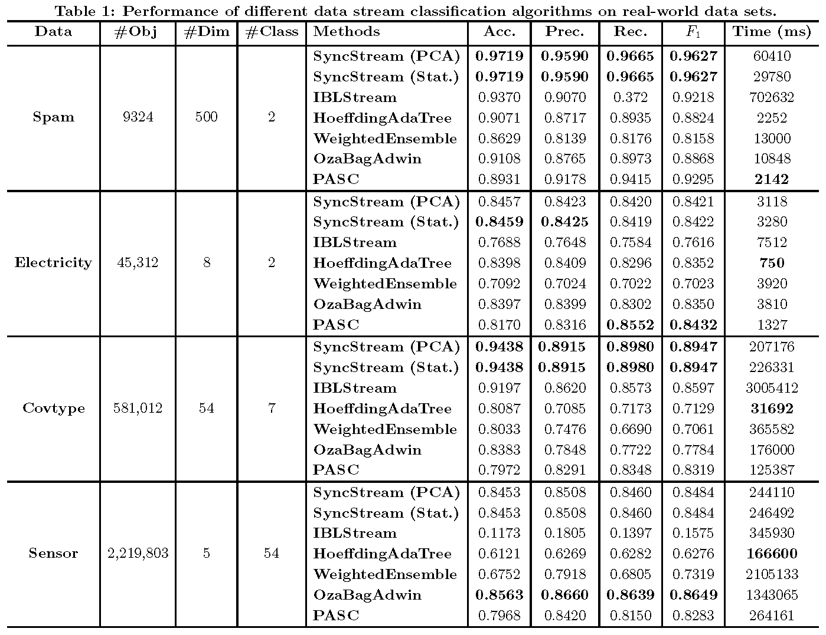
51
Prediction Performance Analysis

Slide 52
3、Data Stream Clustering

Slide 53
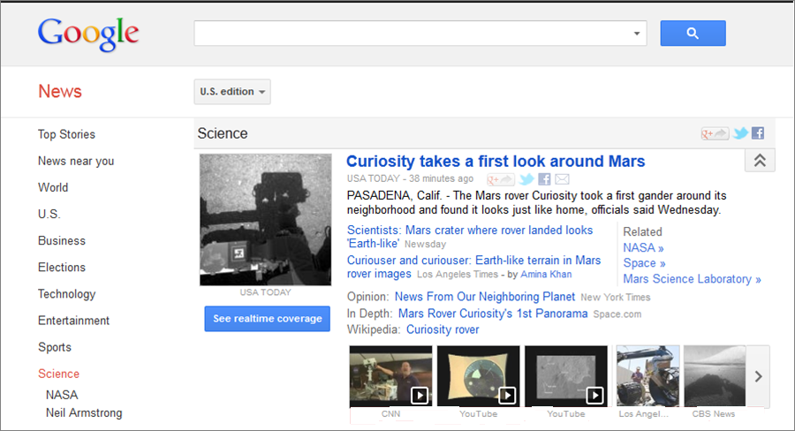
Example: Stream Clustering
Topic cluster
Article
Listings

Slide 54
Data stream clustering Framework
Online Phase
Summarize the data into memory-efficient data structures
Offline Phase
Use a clustering algorithm to find the data partition

Slide 55
Micro-Clusters
A Micro-Cluster is a set of individual data points that are close to each other and will be treated as a single unit in further offline Macro-clustering.
View of Micro-Cluster
View of Macro-Cluster

Slide 56
Stream Clustering Algorithms
Data Structures | Examples
Prototypes | Stream, Stream Lsearch
Cluster Feature | CluStream, ClusTree, DenStream, HP-Stream, Scalable k-means
Grids | D-Stream, ODAC
Coreset Tree | StreamKM++

Slide 57
Cluster Feature: CF = (N, LS, SS)
where N: # data points, LS = , SS =
Key Point: Additivity Property

Slide 58
The CluStream Framework
Micro-cluster
Statistical information about data locality
Temporal extension of the cluster-feature vector
Multi-dimensional points with time stamps
Each point contains d dimensions, i.e.,
A micro-cluster for n points is defined as a (2*d + 3) tuple
Pyramidal time frame
Decide at what moments the snapshots of the statistical information are stored away on disk

Slide 59
CluStream: Pyramidal Time Frame
Pyramidal time frame
Snapshots of a set of micro-clusters are stored following the pyramidal pattern
They are stored at differing levels of granularity depending on the recency
Snapshots are classified into different orders varying from 1 to log(T)
The i-th order snapshots occur at intervals of α^{i} where α ≥ 1
Only the last (α + 1) snapshots are stored

Slide 60

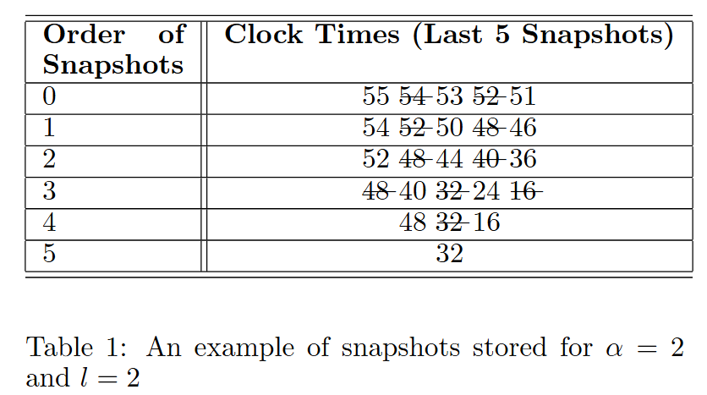

Slide 61
CluStream: Clustering On-line Streams
Online micro-cluster maintenance
Initial creation of q micro-clusters
q is usually significantly larger than the number of natural clusters
Online incremental update of micro-clusters
If new point is within max-boundary, insert into the micro-cluster
o.w., create a new cluster
May delete obsolete micro-cluster or merge two closest ones
Offline Phase: Query-based macro-clustering
Based on a user-specified time-horizon h and the number of macro-clusters k, compute macroclusters using the k-means algorithm

Slide 62
DenStream
Microclusters are associated with weights (Decay function) based on recency
Outliers detected by creating separate micro-cluster.
The “dense” micro-cluster (named core-micro-cluster) is introduced to summarize the clusters with arbitrary shape, while the potential core-micro-cluster and outlier micro-cluster structures are proposed to maintain and distinguish the potential clusters and outliers.

Slide 63
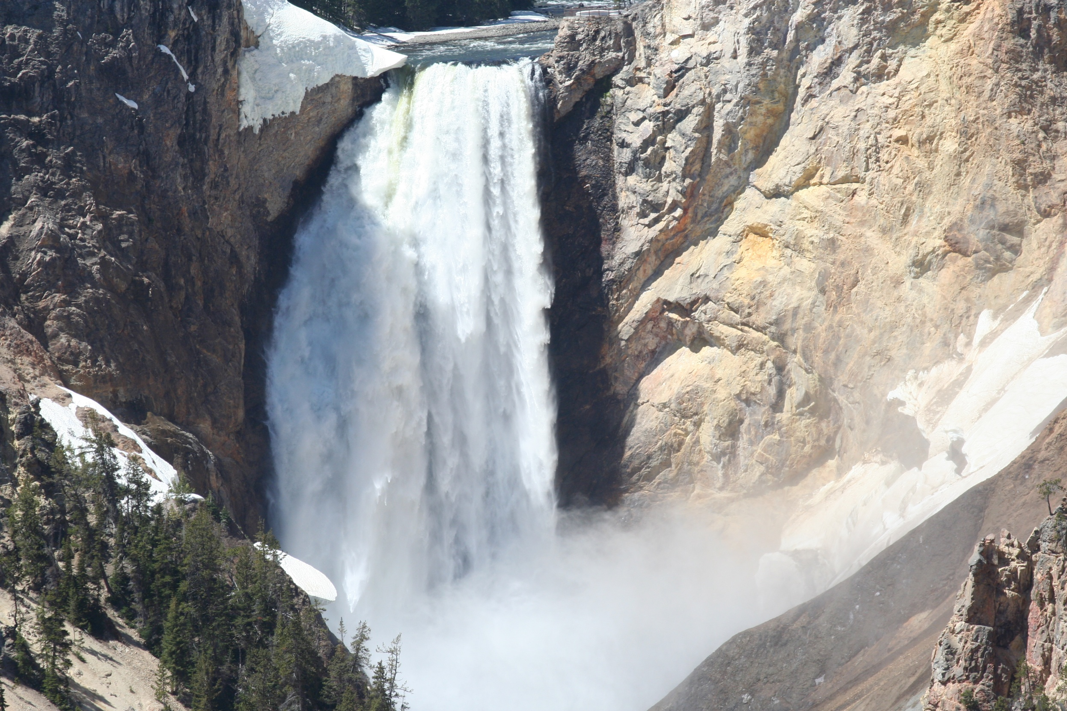

Slide 64
Thanks !!!

